Slide 1
Lecture 13
Cities in History; Urban Precursors: Hunter-Gatherer Camps and Densification
13.1 Cities in History : The Mother of all Social Experiments
IUS 7.1
©Luís M. A. Bettencourt 2024
Notes:
Now that we have started ti get a handle on how cities build and expand their networks, we want to look at available data about the past. The idea is that the kind of science of cities that we developed so far is not specific about modern cities: It should apply to cities from the beginning. Can we test these hypotheses? How far can we push back these ideas?

Slide 2
All workable social systems are predicated on creating reliable forms of cooperation among
an extensive population and then distributing the fruits of that cooperation across the population in ways that prevent the outbreak of catastrophic levels of violence.
—Josiah Ober, The Rise and Fall of Classical Greece, 2015.
Notes:
I like this quote, in cities in history the nature of the social contract was clearer in that the calculus was not done at all in terms of individual economic agents (as arguably it is not done today either). Josh Ober is talking about classical Athens by the way.

Slide 3
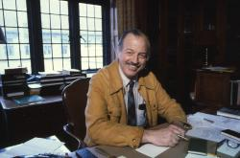
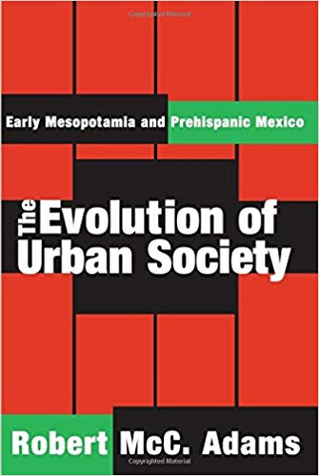
Another UChicago First:
Robert McCormick Adams
“This volume is concerned with the presentation and analysis of regularities on our two best documented cases of early, independent urban societies. It seeks to provide as systematic a comparison as the data permits of institutional forms and trends of growth that are to be found in both of them.
Emphasizing basic similarities in structure rather than the many acknowledged formal features by which each culture is rendered distinguishable from all others, it seeks to demonstrate that both the societies in question can usefully be regarded as variants of a single processual pattern.”
Mesopotamia
?
Basin of Mexico
https://www.routledge.com/The-Evolution-of-Urban-Society-Early-Mesopotamia-and-Prehispanic-Mexico/Adams/p/book/9780202308180
Notes:
There is one singular “natural experiment” on cities that is in some sense the mother of all experiments. It is thought that the people that when humans came to the Americas they did not have cities: in this sense Ancient American cities were invented independently from those in the new world (which could have been in touch with each other). This natural experiment has been used to discuss the advent urban societies by archeologists, like Adams who was also at the university of Chicago.

Slide 4
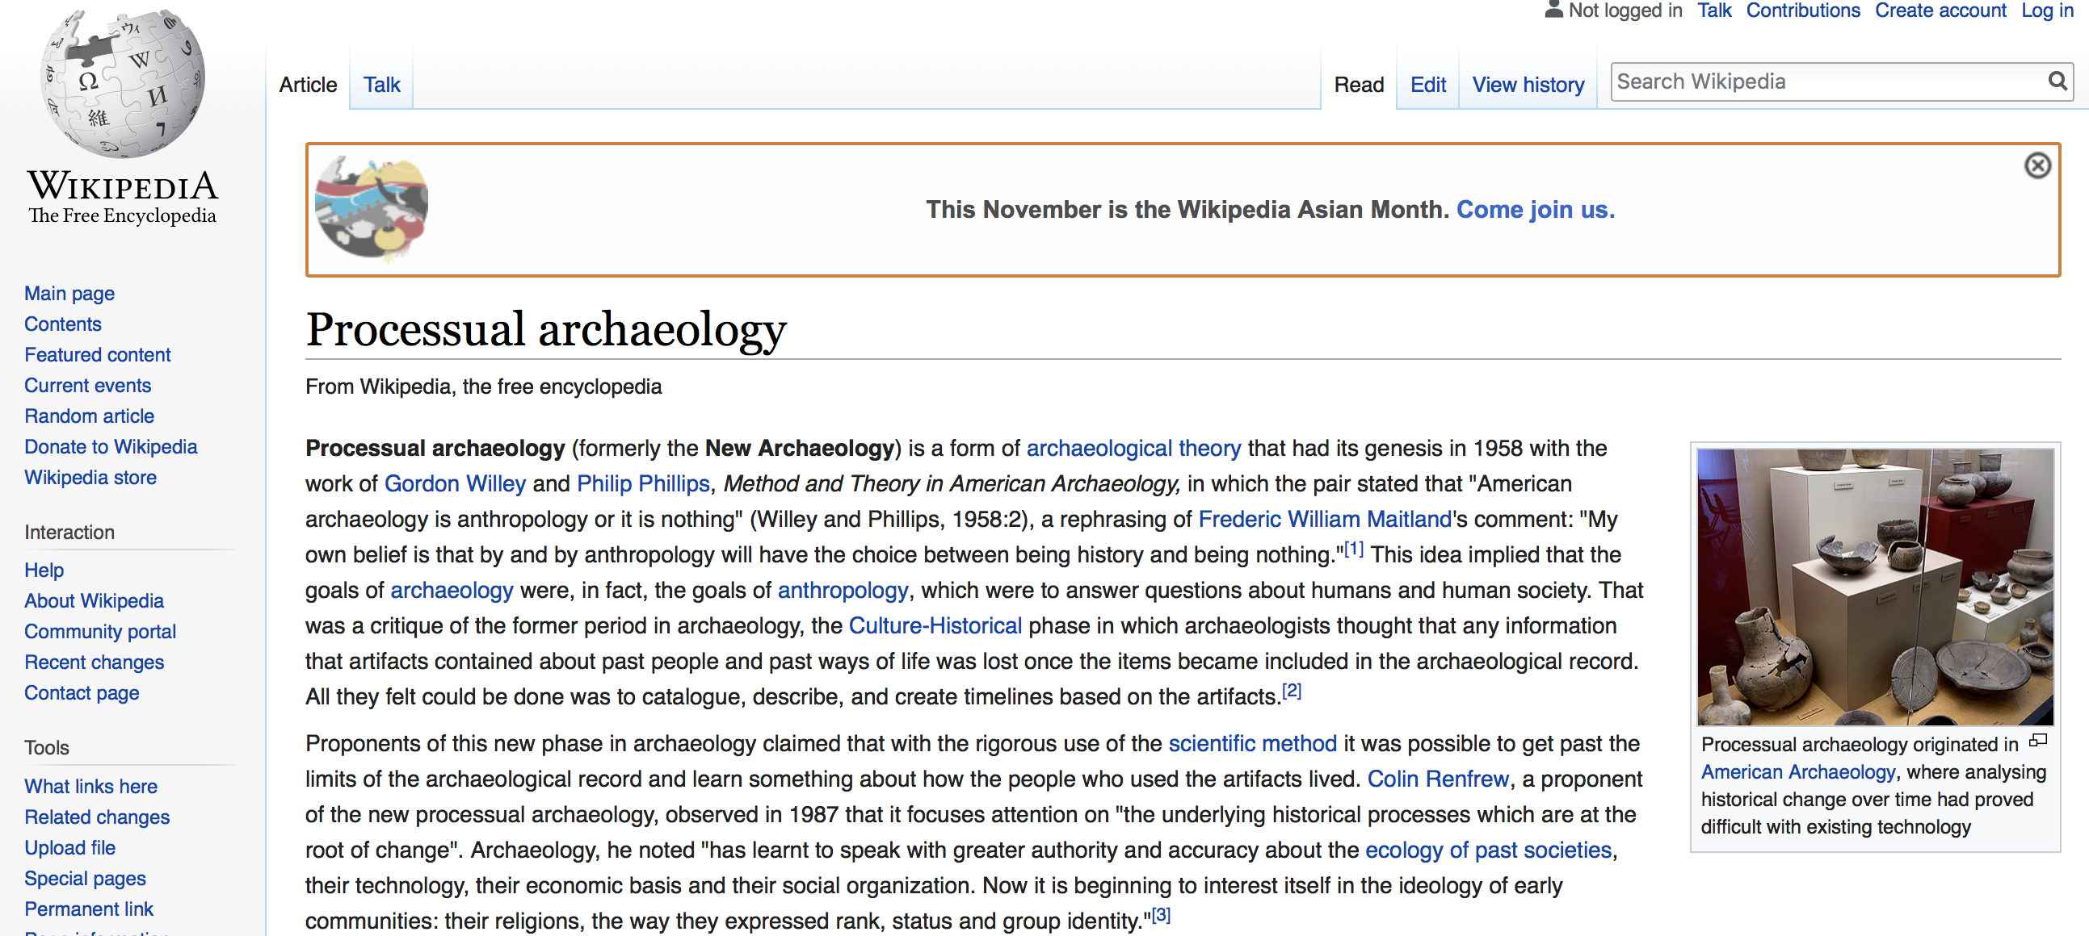
Notes:
This is also a time when archeology and anthropology were shifting conceptually, and where focus on processes like in other sciences, rather than form or materials was gaining relevance.

Slide 5
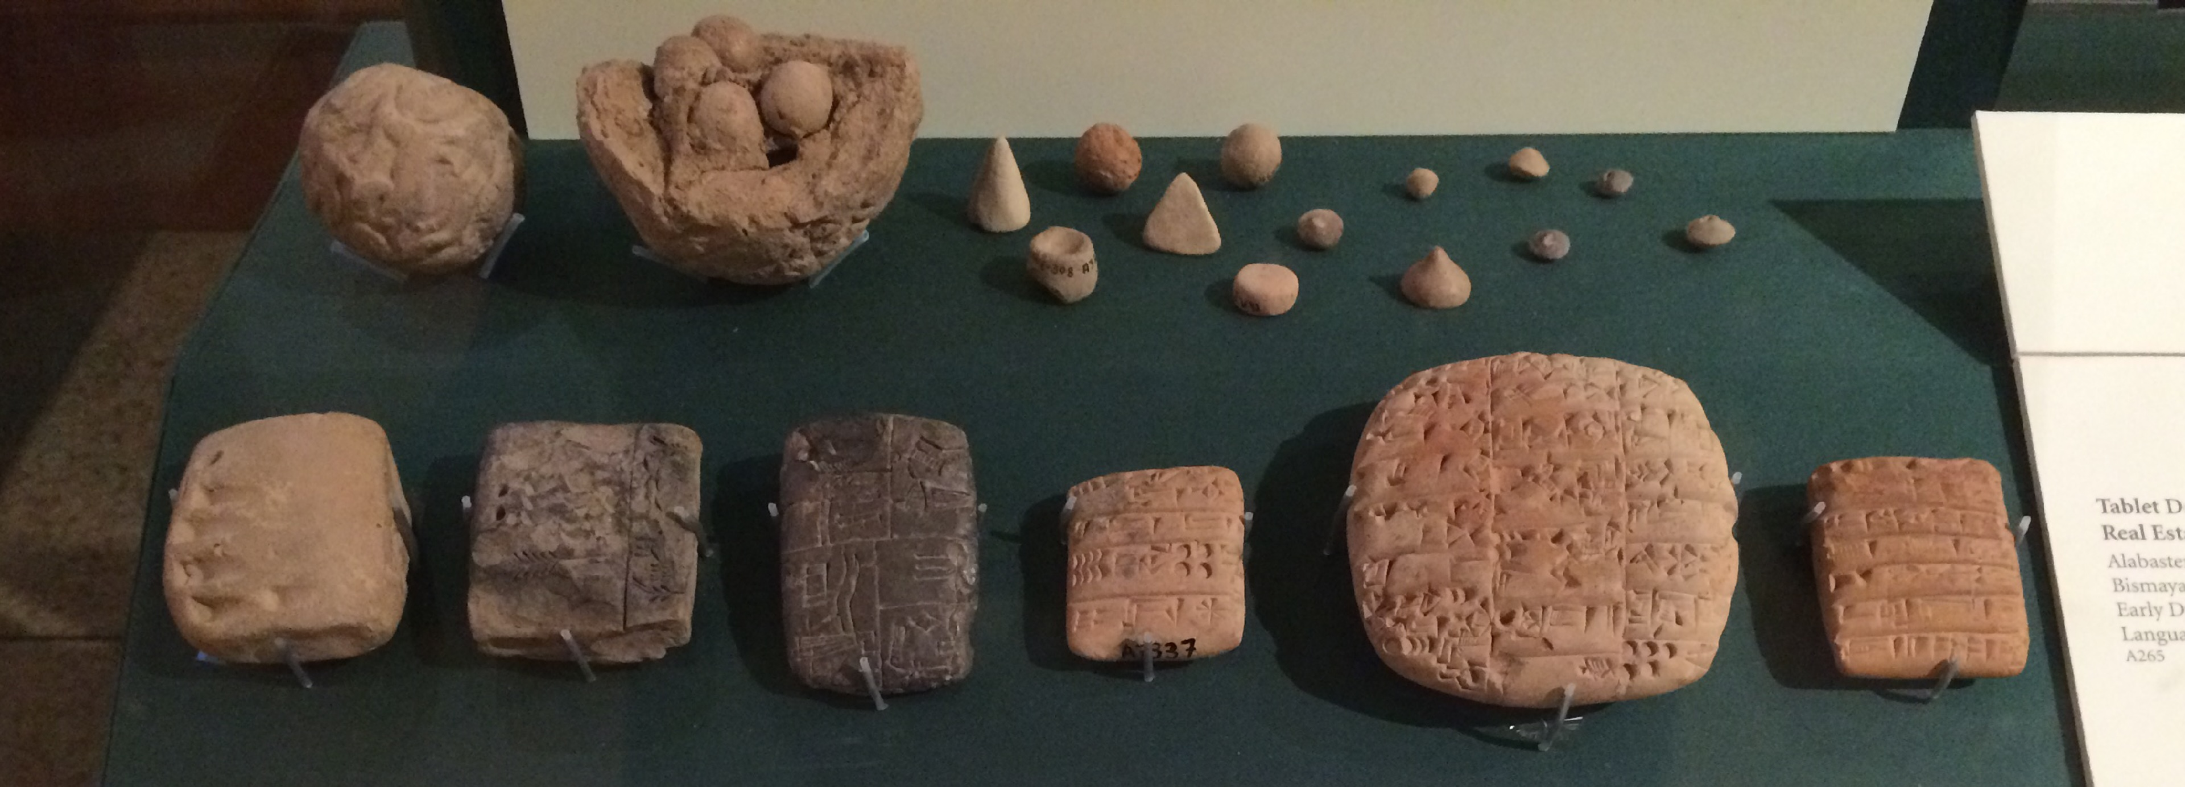
The advent and evolution of writing
credit: Oriental Institute
Notes:
There are a number of technological innovations and institutions that emerge with the first cities: one is writing, which initially was simultaneously accounting (mathematics and data) and writing. Data and text emerged together, from the need to keep track of things and preserving collective memory.

Slide 6
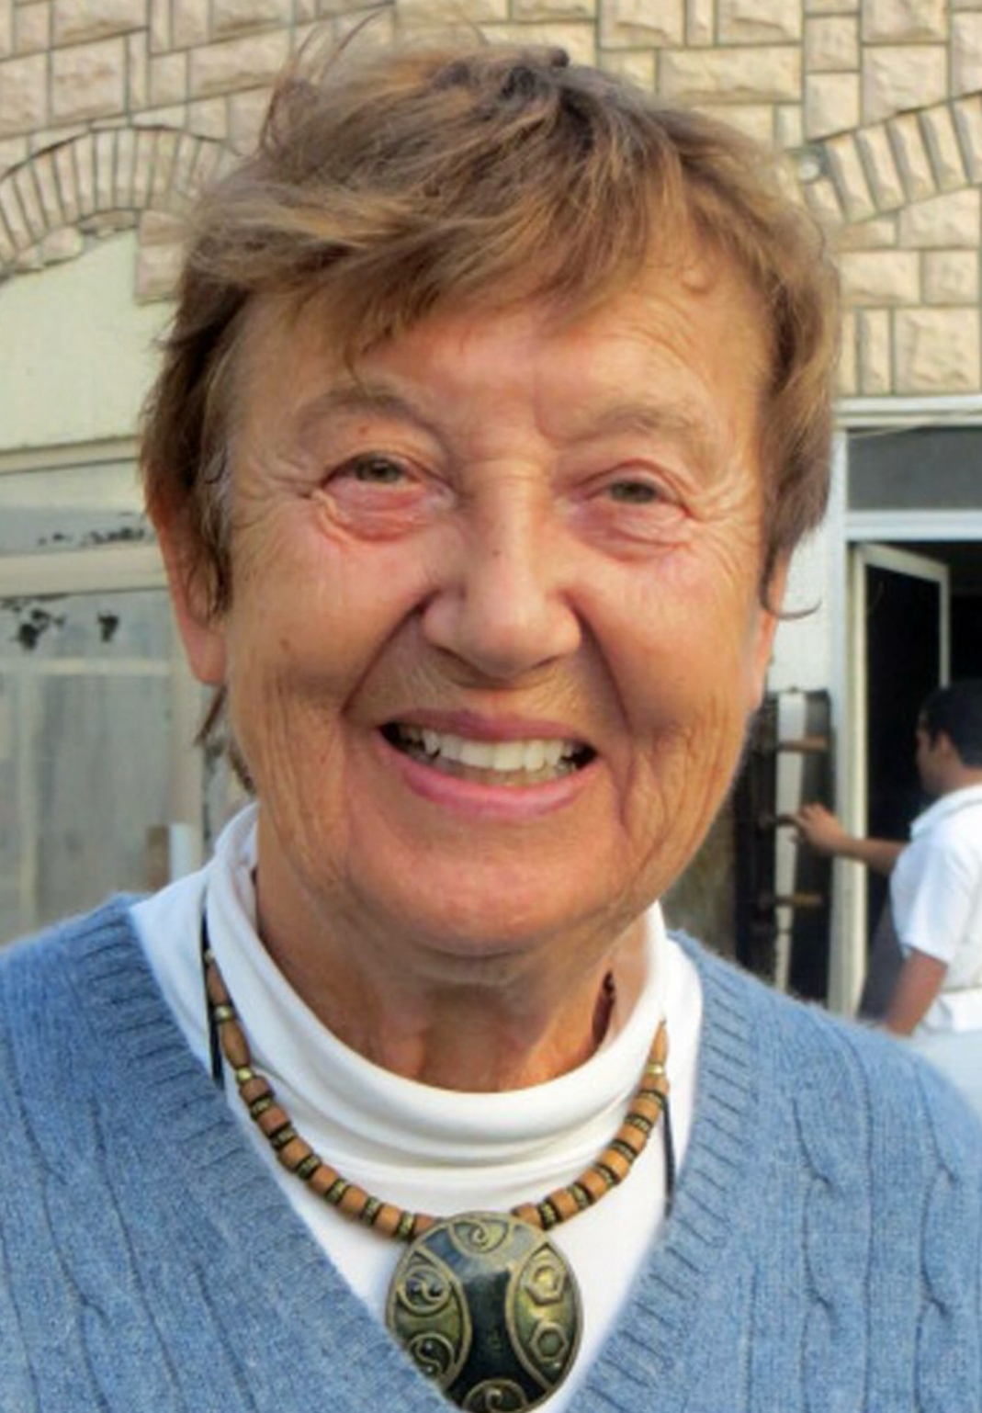
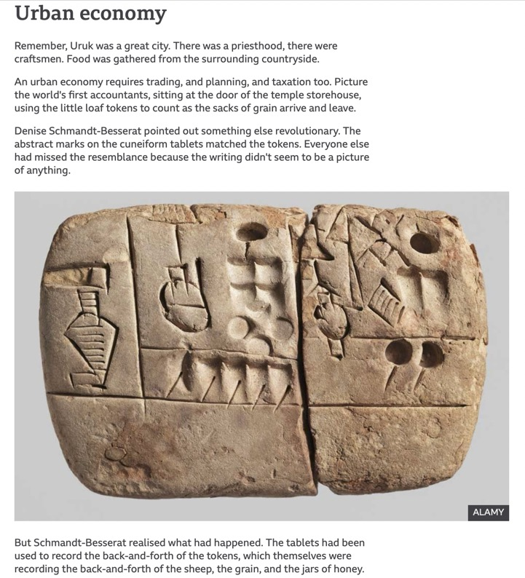
Denise Schmandt-Besserat
https://www.bbc.com/news/business-39870485
Notes:
Many of the uses of early writing were trade documents…

Slide 7
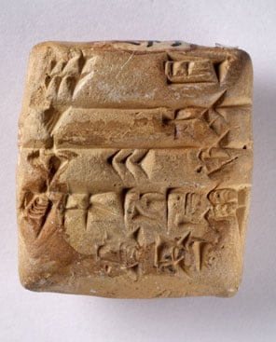
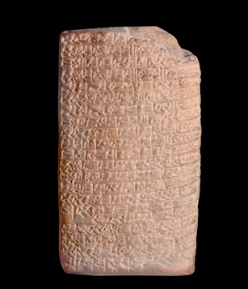
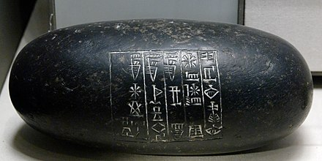
Letters (and numbers) from the first cities
Political document
Bridegroom, dear to my heart,
Goodly is your beauty, honeysweet,
Lion, dear to my heart,
Goodly is your beauty, honeysweet.
You have captivated me, let me stand tremblingly before you.
1-5. Six lambs, one (goat-)kid, day 30,
from Abbasaga, Intaea took in charge.*
[ it then gets pretty racy ! ]
The Love Song of Shu-Sin
https://www.worldhistory.org/article/750/the-worlds-oldest-love-poem/
Notes:
But soon, they became humanism too: such as poems. These are the first voices that we can hear throughout history: it began with the necessities but also expanded range in invention and self-expression that arose with cities.

Slide 8
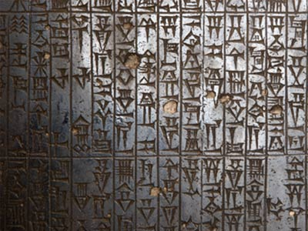
The “Urban Package”
Symbolic Culture
Accounting, written language, standard weights and measures, time and socioeconomic planning, (money comes later)
Division of Knowledge and Labor; Social Interdependence
Public Goods
monuments, aqueducts, streets, walls
Social Contracts (law), Resource Redistribution, Social Policy
managing inequality, insecurity and conflict
The result is (fast) cumulative culture:
A symbolic encoding of memory and actions that holds societies together
Code of Hammurabi
Societies Learn, History begins
Notes:
At this time, people can tell time and invent many others institutions: knowledge can start to accumulate and history, in a sense, begins. Most of these properties exist in all cities: I like to call them the “urban package”. Technologies to implement these functions are of course very different today, and will be so in the future. But the functions themselves are predictable and conserved.

Slide 9
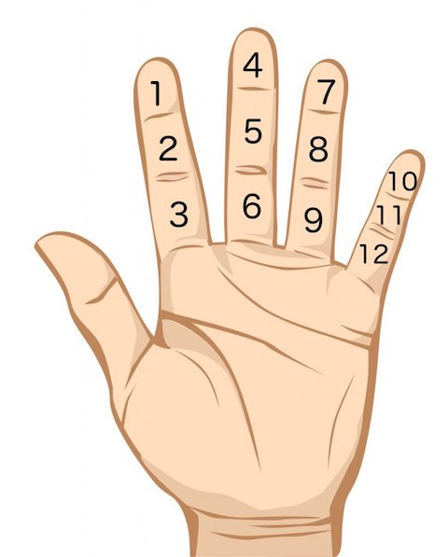

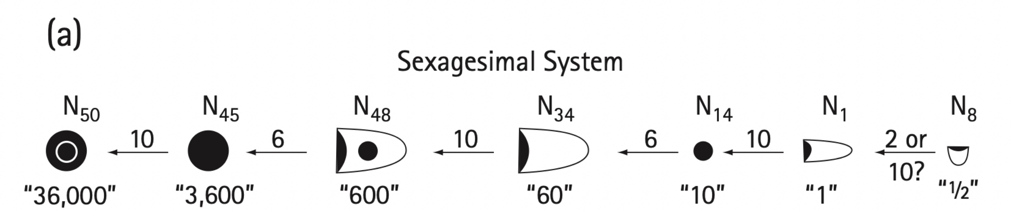

why do we tell time this way? angles, latitude, longitude?
Credit: ScienceABC
Notes:
The most amazing thing that is with us today from the cities of Sumer is the sexagesimal system, that we still use to tell time (and angles, including the coordinate system for the entire planet). Each great city originates fundamental ideas, that in turn spread everywhere and are largely preserved (and elaborated) over history: isn’t that amazing?

Slide 10
What ideas did we get from other great cities in the past?
Babylon
Athens
Rome
Paris
London
Tokyo
NYC
Beijing
Mumbai
insert you favorite city…
Lagos
Notes:
I leave it as an exercise what things we got from these cities that we still all use. I’d personally like to have more examples from Asian (and African) cities, which are often very old but whose history I know less well.

Slide 11
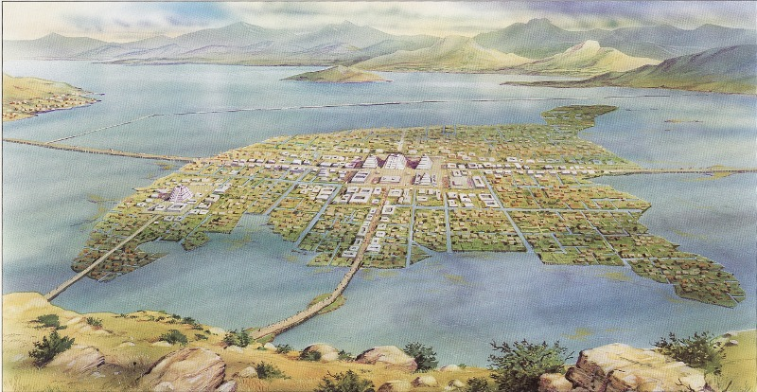
Tenochtitlan
Aztec capital, ~200,000 people
The mother of all social experiments
Notes:
OK: now back to the mother of all urban experiments. The great cities of the Americas: At the time of European conquest Tenochtitlan (today’s Mexico City) was the largest city in the Americas and one of the largest in the world. This is an artists guess, but it may have looked a little like that. Much transportation was done by water.

Slide 12
we beheld on that great lake a great multitude of canoes, some coming with supplies of food and others returning loaded with cargoes of merchandise; and we saw that from every house of that great city and of all the other cities that were built in the water it was impossible to pass from house to house, except by drawbridges which were made of wood or in canoes; and we saw in those cities temples and oratories like towers and fortresses and all gleaming white, and it was a wonderful thing to behold….
After having examined and considered all that we had seen we turned to look at the great market place and the crowds of people that were in it, some buying and others selling, so that the murmur and hum of their voices and words that they used could be heard more than a league off.
Some of the soldiers among us who had been in many parts of the world, in Constantinople, and all over Italy, and in Rome, said that they had never beheld so large a market place and so full of people, and so well regulated and arranged.
Bernal Diaz del Castillo
True Story of the Conquest on New Spain (1568) about 1519
Notes:
The Spaniards were amazed by Tenochtitlan, but note how they did not find the city that unfamiliar: they readily identified trade, houses, bridges, towers and fortifications, temples, markets, buzz and so on… Cities looked in many ways like their old world counterparts, even though they were “invented” independently.

Slide 13
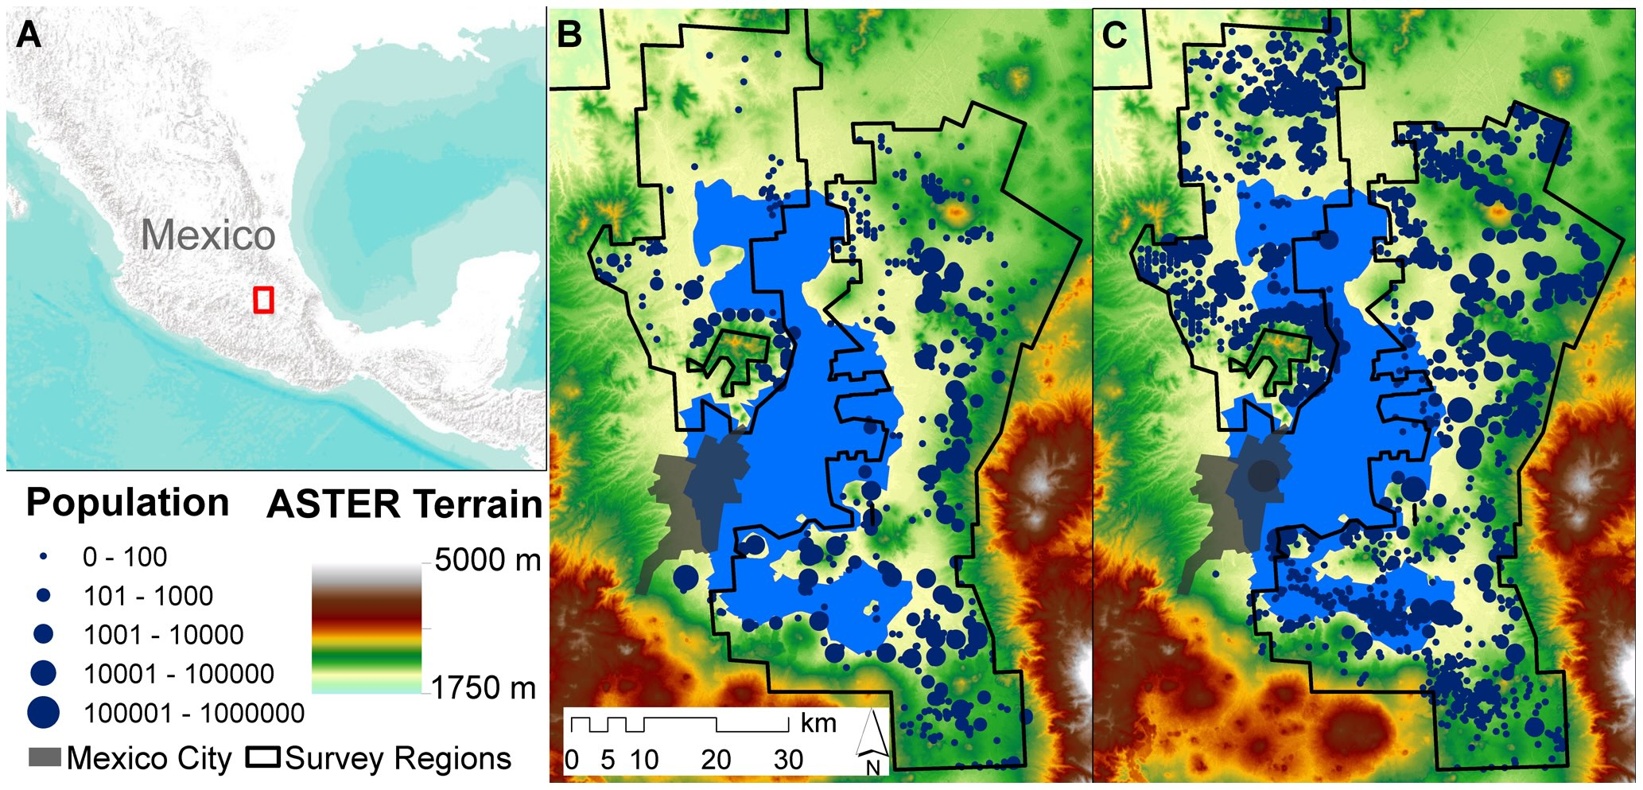
The Valley of Mexico
Formative Period
1150 B.C.E.–150 B.C.E
Aztec Period
1200–1519 C.E.
mexico city 1960
technotitlan
Ortman, Cabaniss, Sturm, Bettencourt 2014
https://journals.plos.org/plosone/article?id=10.1371/journal.pone.0087902
Notes:
But let’s not stick with one city and look at the urban system instead. We will use the tools of urban scaling to investigate if these cities had similar properties to modern cities, as we would predict (there was nothing special to urban scaling theory that was about modern cities). These were the settlements of the basin of Mexico over different periods. Look at the link if you want to know more.

Slide 14
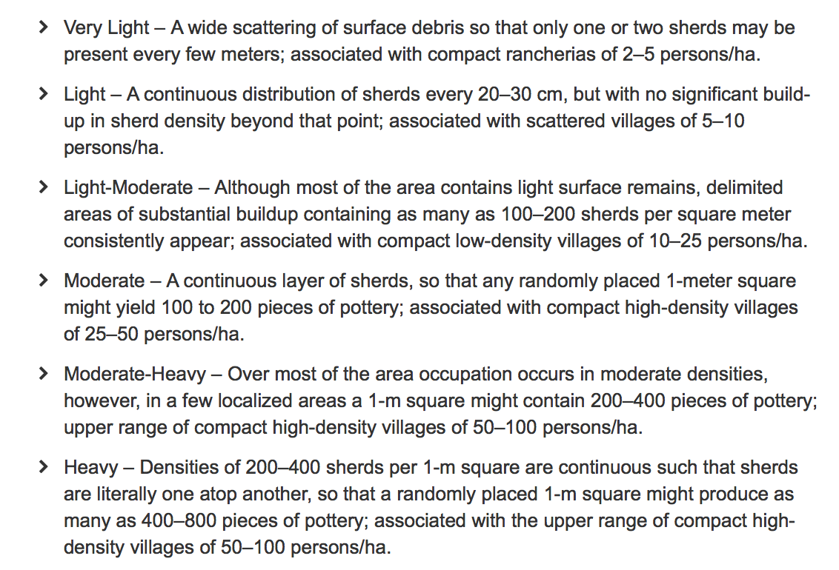
Population Density Estimation in Archeology
Method 1: Sherd densities
Method 2: Room and house counts
multiply room occupancy by total number of rooms
Notes:
In archeology, you cannot count people easily to estimate population. You need proxies, such as the amount of trash accumulated, or the number of rooms where they may have slept. Through these quantities archeologists can measure both population and area independently.

Slide 15
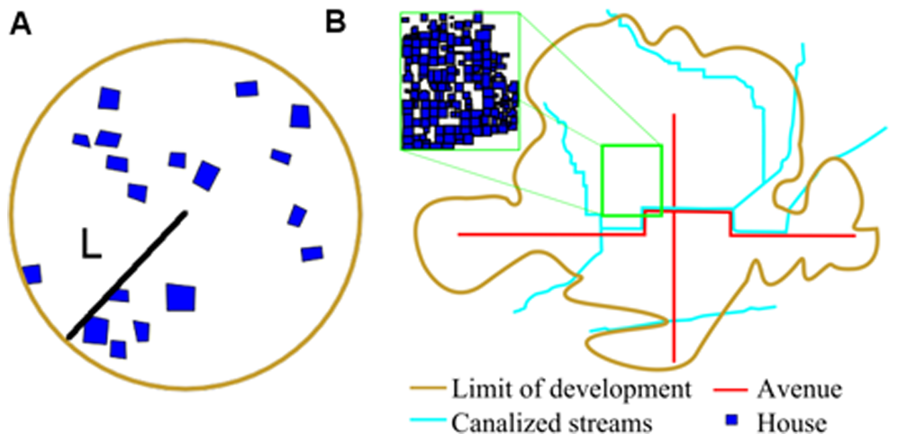
Networked versus Amorphous Settlements
can we tell the difference?
How does the total built area of the settlement depend on its population?
$$A(N)=A_{0}N^{α}$$
$$A_{n}(N)=A_{0}N^{ν}$$
$$α≃2/3$$
$$ν≃5/6$$
Notes:
As we had seen, there may be different scaling relations (exponents) for settlements that are amorphous and those organized around infrastructure networks. Can we tell them apart in archeological settings? (We expect a lot of small settlements to maybe amorphous as they were quite small and basic).

Slide 16
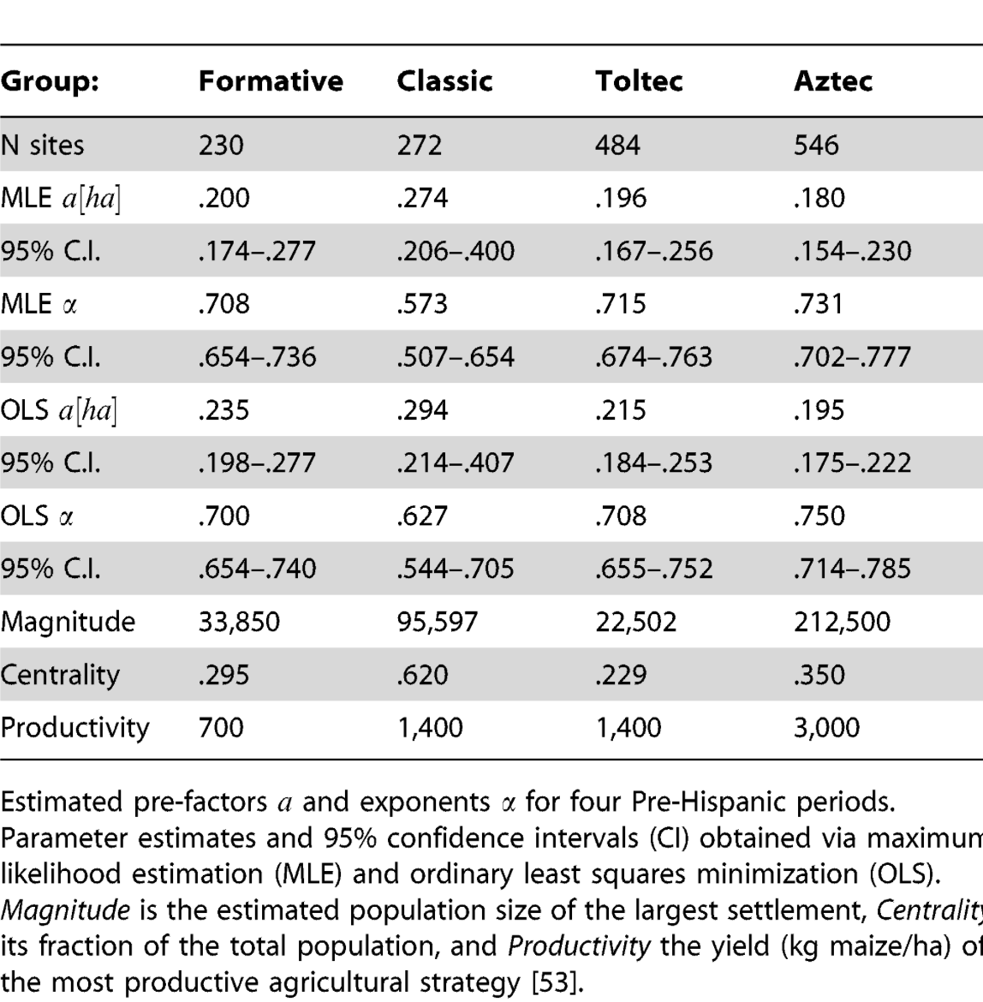
Spatial Densification
if you throw all the data together
one ha per household baseline
Sublinear
https://journals.plos.org/plosone/article?id=10.1371/journal.pone.0087902
Notes:
We can then do scaling analysis as a first pass. We do find that the area of settlements is sublinear on population in the range expected, and across historical periods.

Slide 17
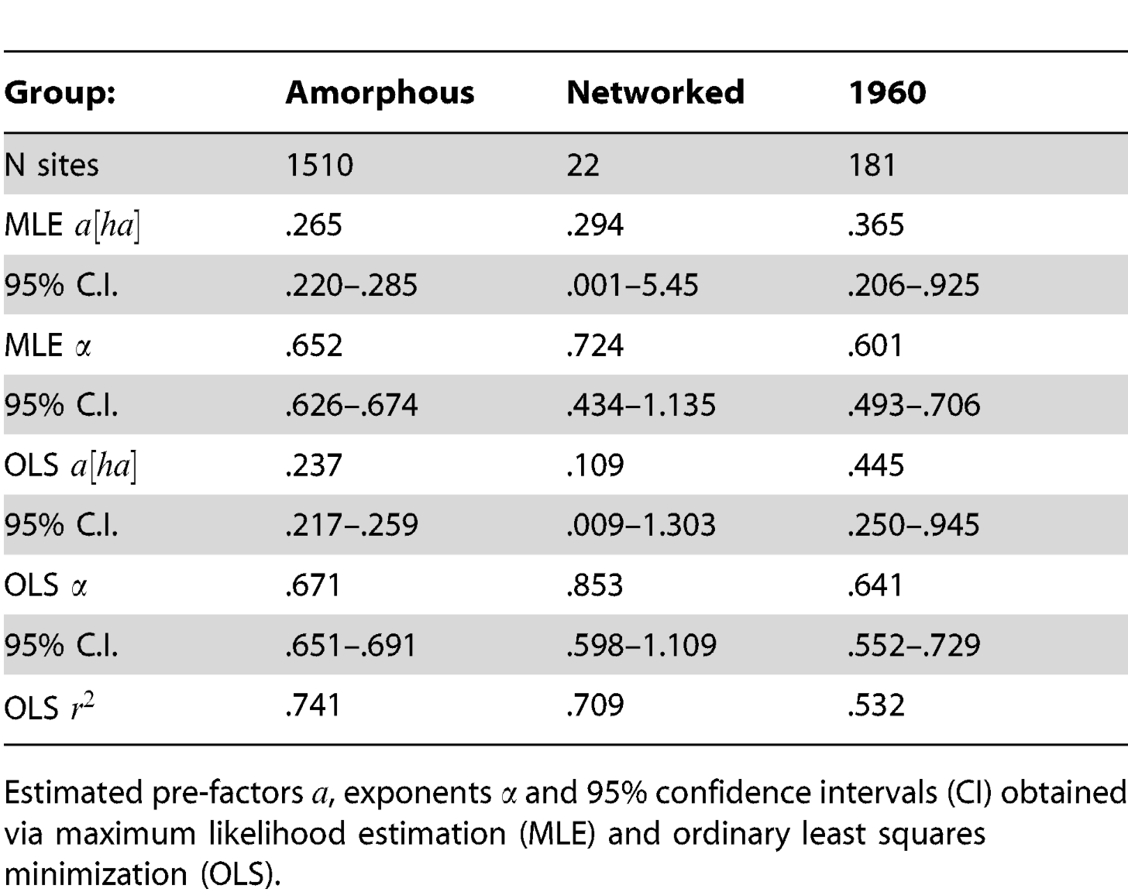
Spatial Densification
stratified by amorphous vs networked settlements
Sublinear
https://journals.plos.org/plosone/article?id=10.1371/journal.pone.0087902
Notes:
But it gets better: if we divide settlements in small amorphous ones and networked we get the expected exponents.

Slide 18
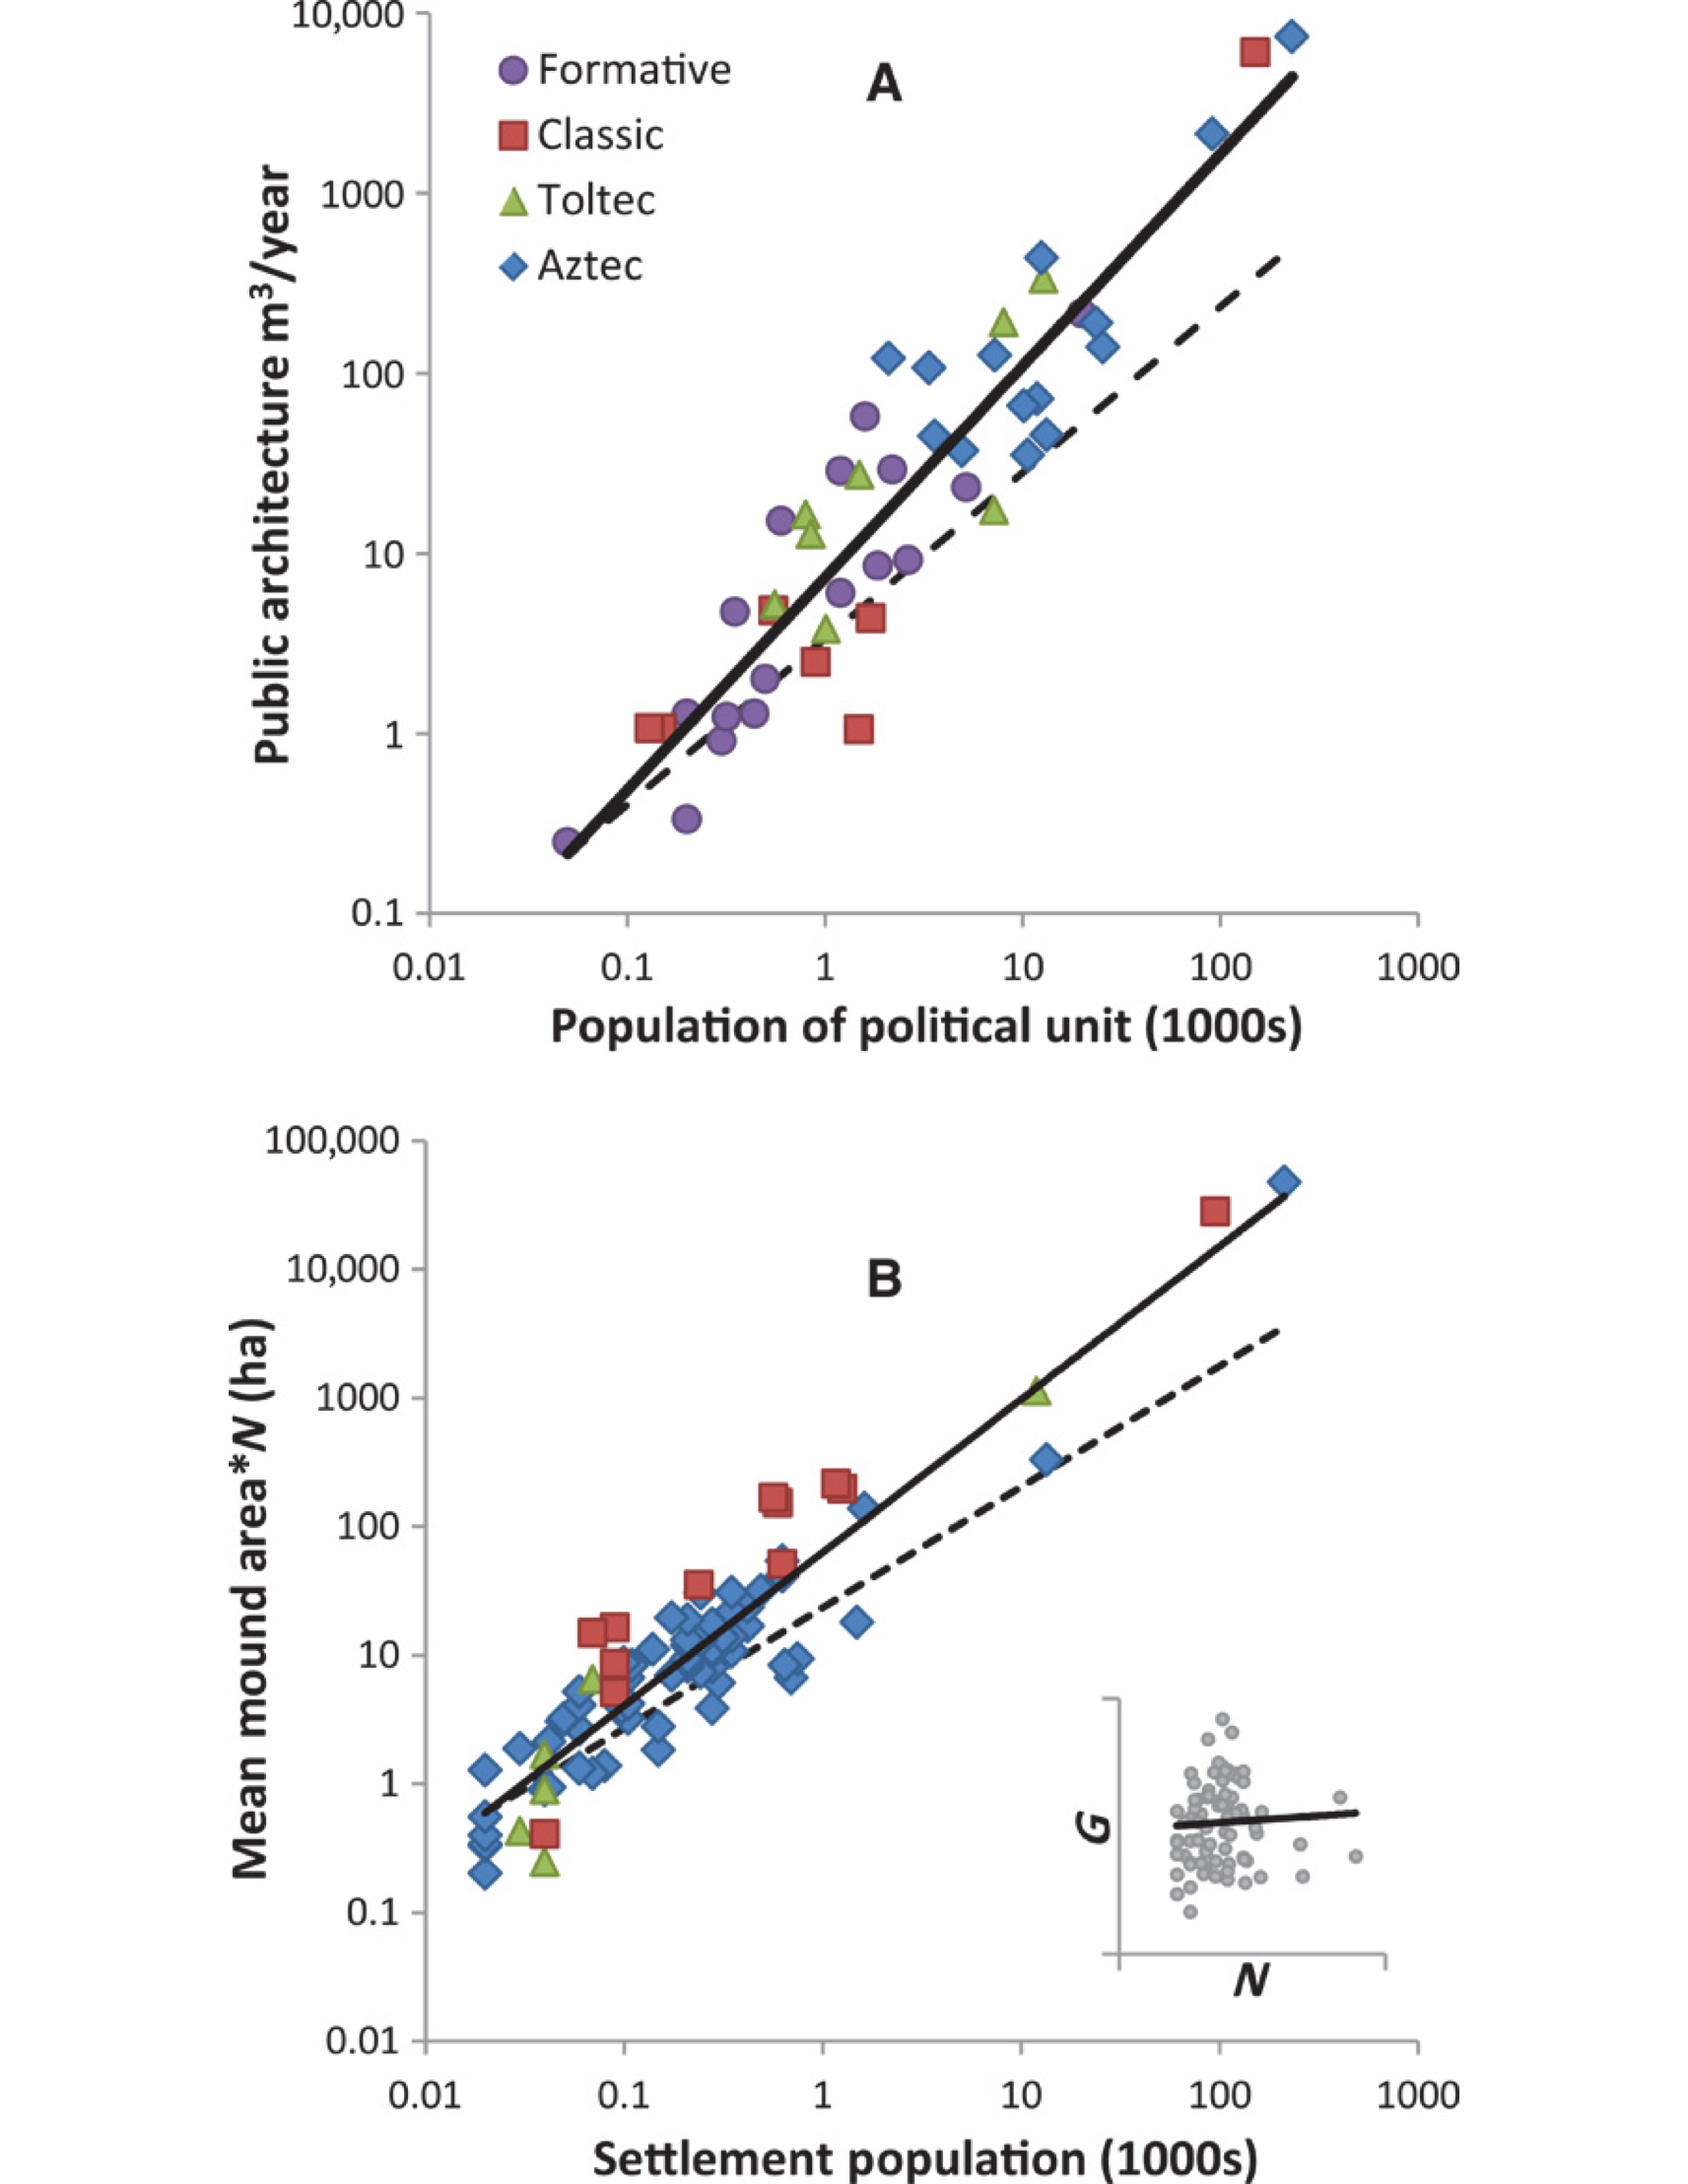
Where did ancient societies put their wealth?
Increasing returns in Monument Volume
Superlinear
Increasing returns in Home Construction
Superlinear
https://www.science.org/doi/10.1126/sciadv.1400066
Notes:
Then, you can also try to identify evidence in the archeological record of what these societies would consider wealth… we find superlinear behavior in the expected range for house sizes and monuments !

Slide 19
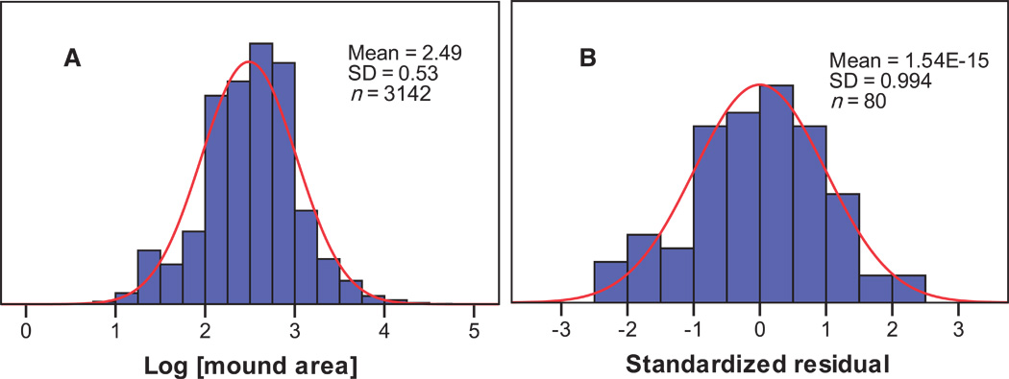
Approximately Lognormal “Wealth” Distribution
So Basin of Mexico City show scaling relations similar to modern cities, but with appropriate quantities
https://www.science.org/doi/10.1126/sciadv.1400066
Notes:
The distributions are also approximately lognormal, as would have been predicted. So, ancient urban systems can behave much like modern ones, in terms of the signatures of their social interactions over space and their social productivity. Note that none of this requires (or depends much) on technology, economic system, or political system. It is much more general than that.

Slide 20
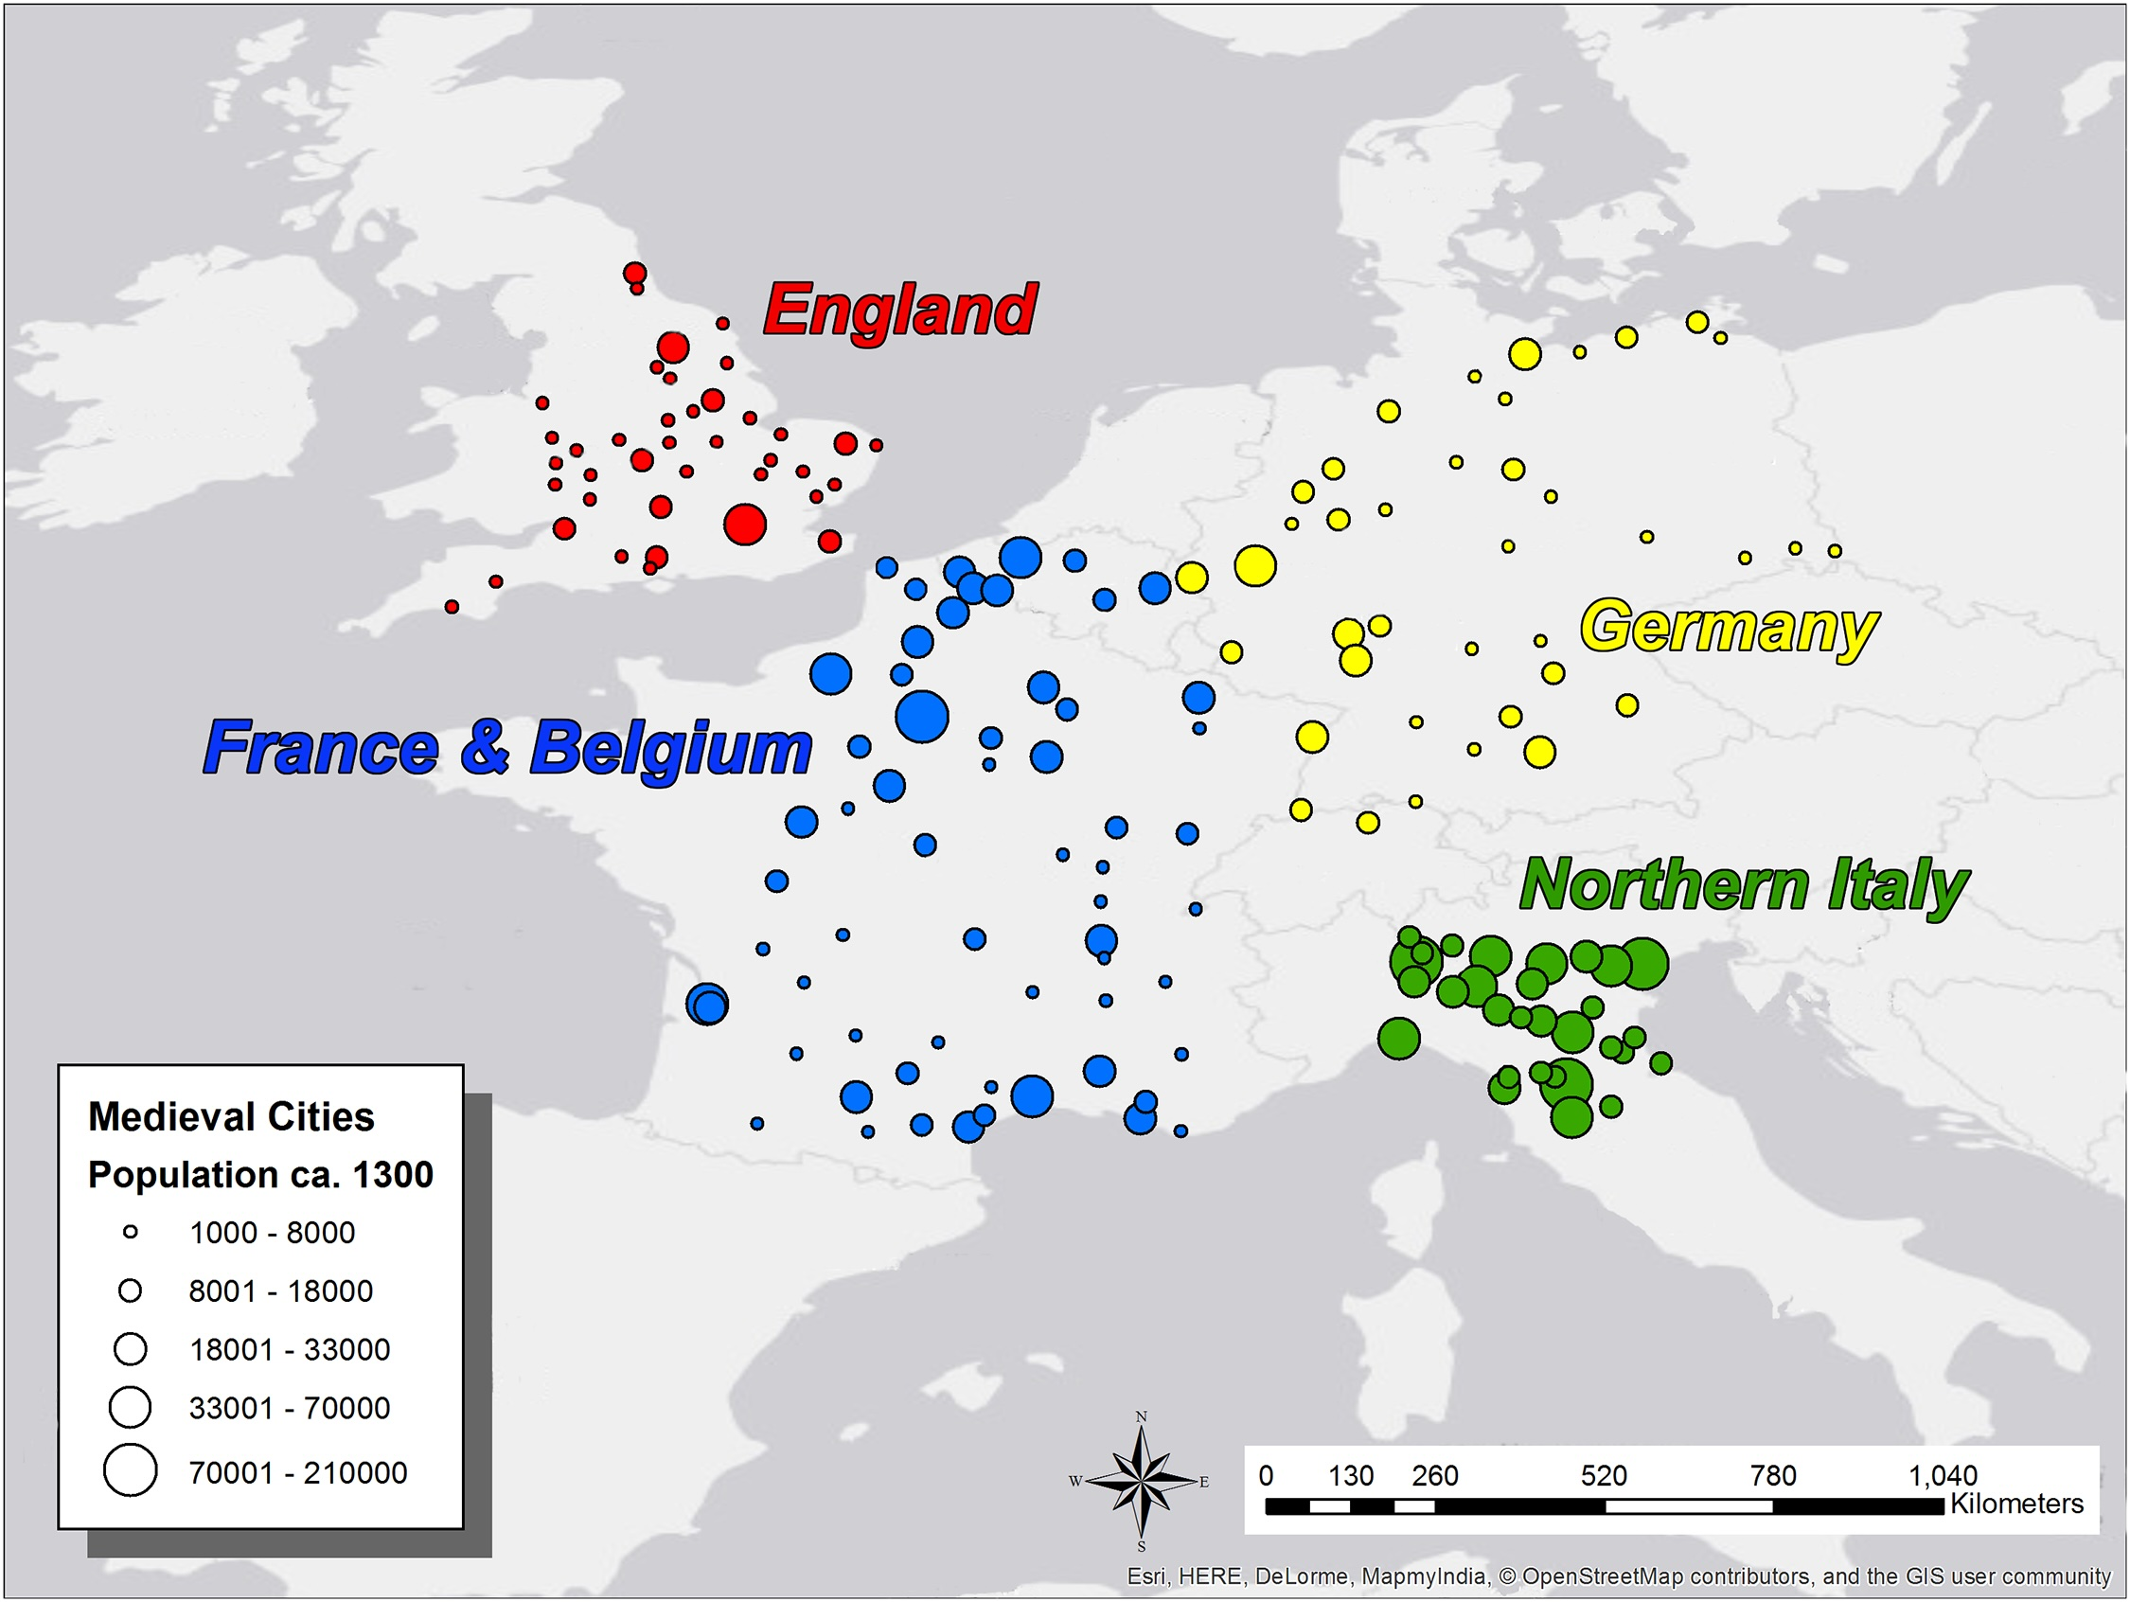
Medieval European Cities ca 1300
Cesaretti et al 2016
https://journals.plos.org/plosone/article?id=10.1371/journal.pone.0162678
Notes:
OK, we will now just show a few additional examples from other periods. This is Medieval Europe around 1300. The biggest city of this set is Paris, with about 200,000 people. Note how the cities of Germany and England were still quite small. The largest city in Germany at this point was Cologne. By contrast Northern Italy and Belgium had well developed urban systems then.

Slide 21
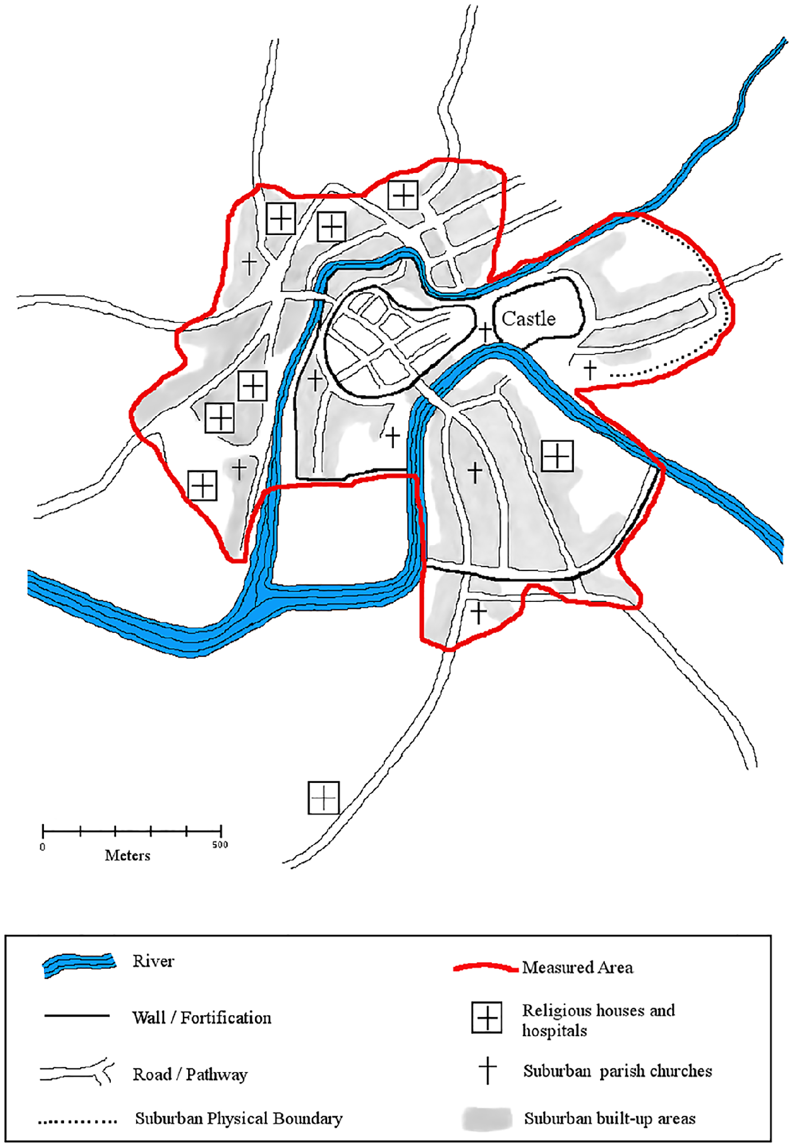
How to measure urban area?
Bristol
Cesaretti et al 2016
Notes:
Rudy Cesaretti estimated the area of these cities by examining historical maps and other documents, one by one, here is the example of Bristol.

Slide 22
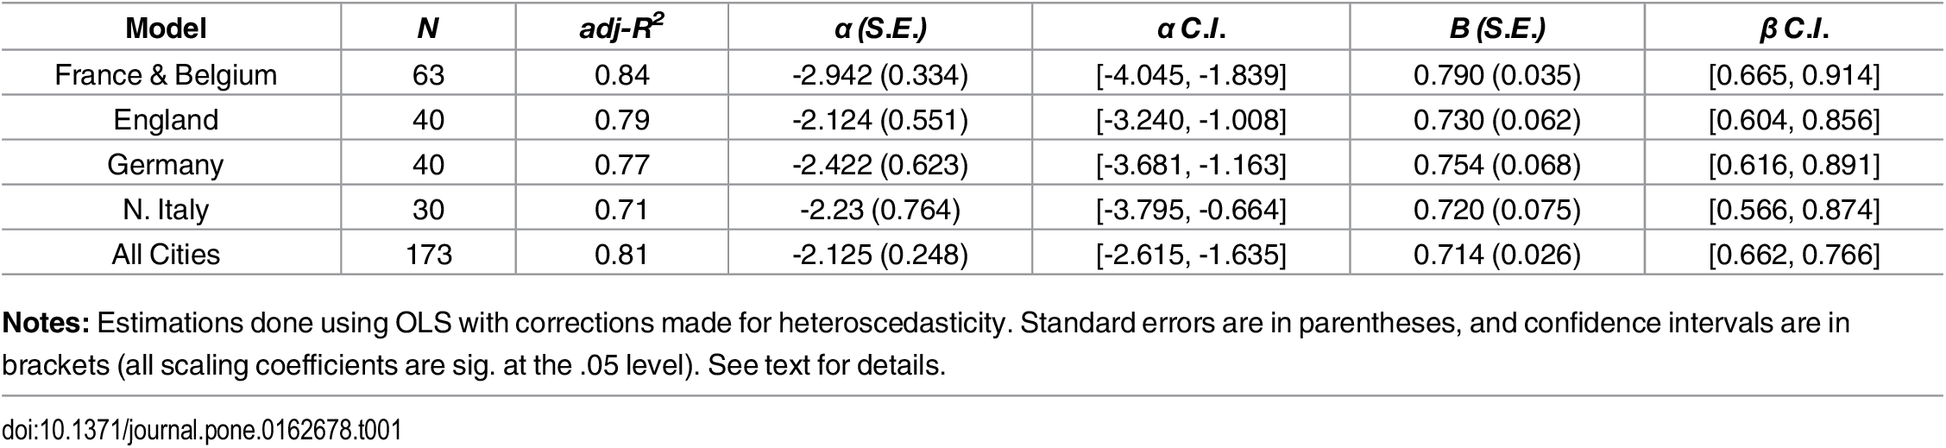
Spatial Densification
Cesaretti et al 2016
https://journals.plos.org/plosone/article?id=10.1371/journal.pone.0162678
Notes:
When you put all this together, you do find the expected sublinear behavior of area on population, with exponents between the amorphous and networked settlements but also with some statistical uncertainty that could include one or the other but is decidedly sublinear.

Slide 23
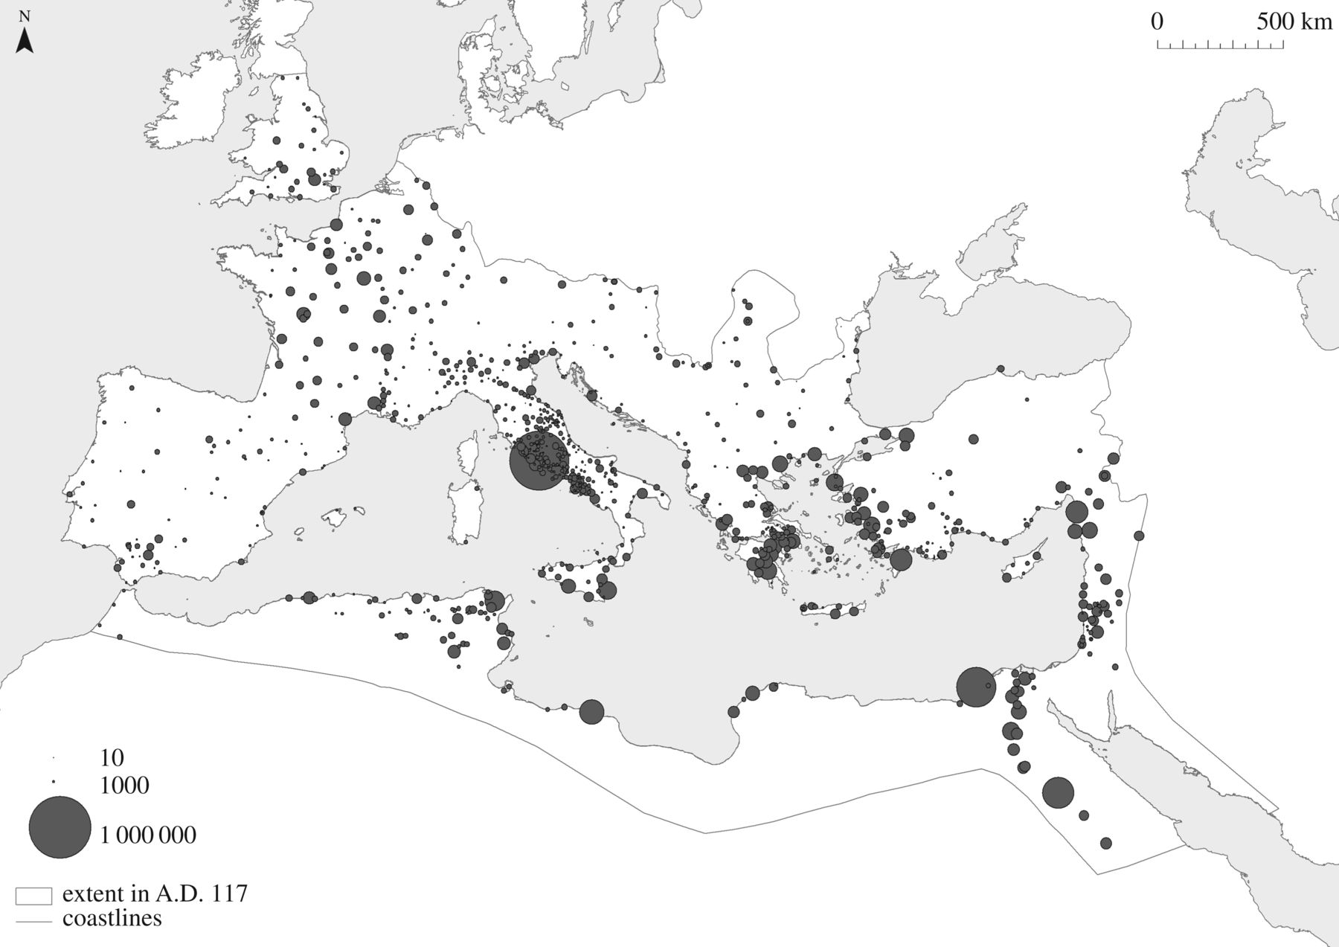
Roman Empire?
credit: J W Hanson
http://www.archaeopress.com/ArchaeopressShop/Public/displayProductDetail.asp?id=%7B20D434EB-311A-4576-9571-EC9498B08665%7D
Notes:
An amazing study led by Jack Hanson and Scott Ortman examined roman cities circa 1AD. Here is the map: Rome itself with about 1 million people was by far the largest city in Europe. (Alexandria was the second biggest). Note also the emergence of Gaul (France) and even England, where most large cities were founded by the Romans.

Slide 24
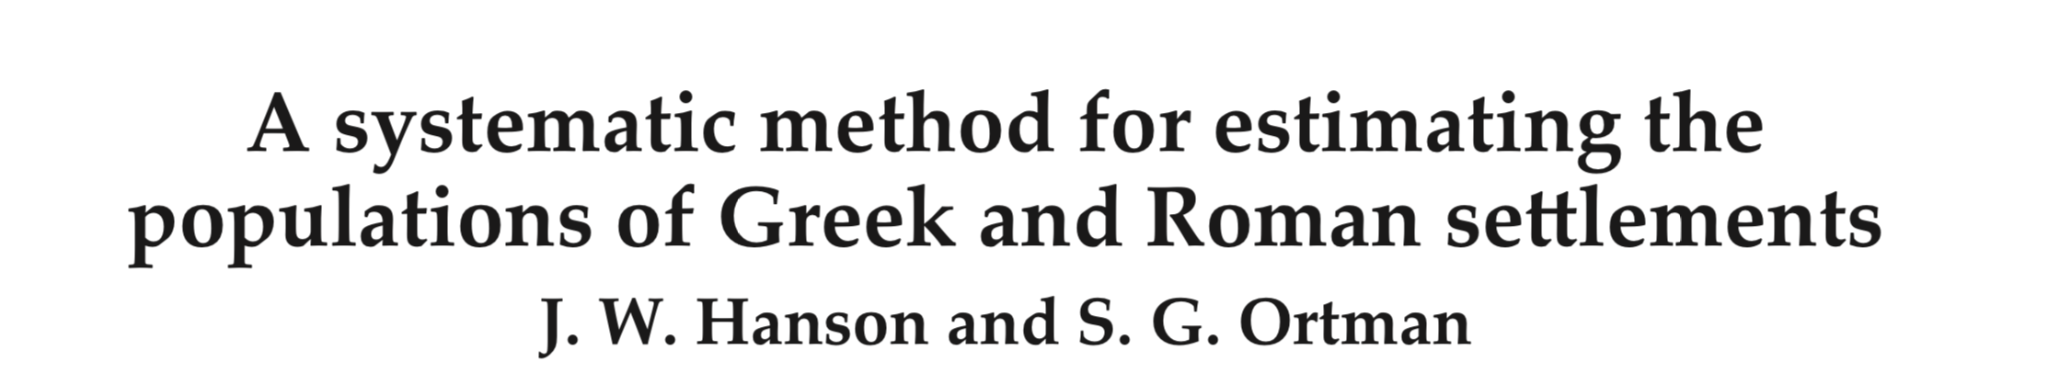
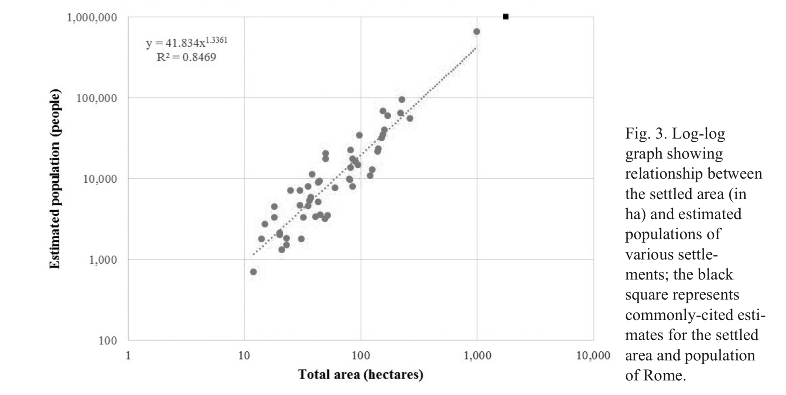
Hanson, Ortman 2017
https://www.cambridge.org/core/journals/journal-of-roman-archaeology/article/systematic-method-for-estimating-the-populations-of-greek-and-roman-settlements/32413192CB46847949394D750342B5D4
Notes:
Hanson and Ortman showed that they could use scaling to predict the population of Rome, from other cities in the system.

Slide 25
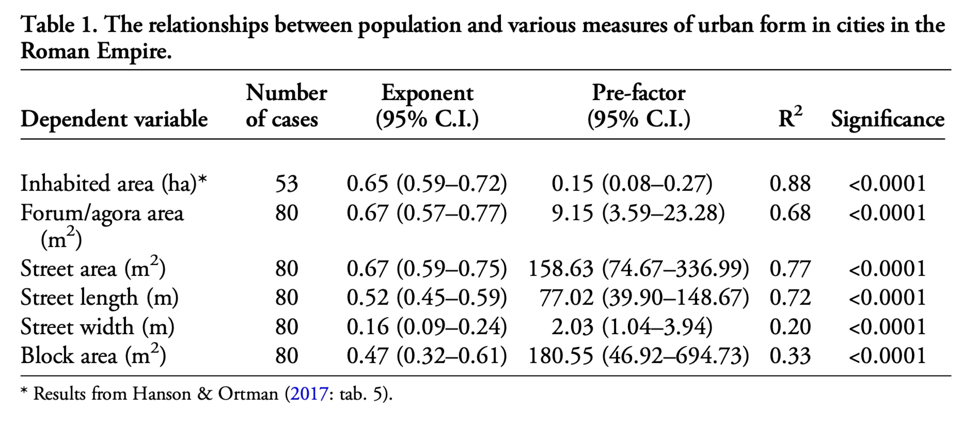
consistent with $δ=1/3$
https://www.cambridge.org/core/services/aop-cambridge-core/content/view/0A1433E14B6469E08B2B027B7C54ED6B/S0003598X18001928a.pdf/urban-form-infrastructure-and-spatial-organisation-in-the-roman-empire.pdf
Notes:
We then examined many of the other characteristics of (a subset of) Roman cities. Exponents are typically sublinear for spatial quantities but interestingly some exponents are closer to 2/3. We developed a little theory that this is related to the structure of blocks (a bit like slums) in many of these cities, and also the lack of 3 dimensional infrastructure in dense cities. These cities were probably very congested as a result.

Slide 26
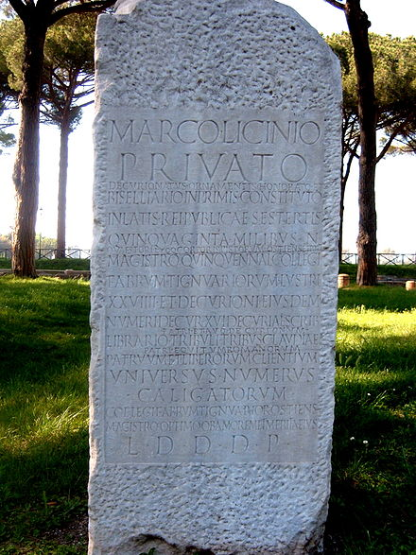
college of carpenters
Notes:
Hanson, Lobo and Ortman also looked at the division of labor in Roman cities, out of these stele (stone inscriptions) which were very common.

Slide 27

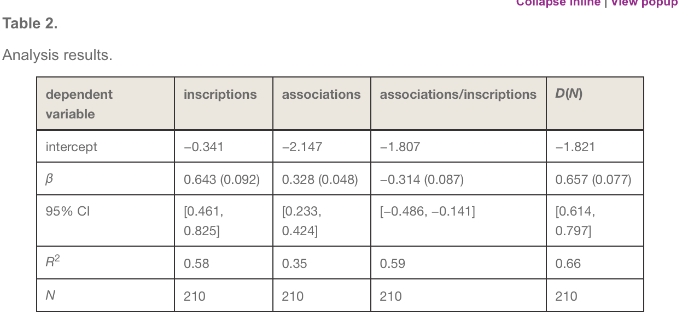
sublinear
https://royalsocietypublishing.org/doi/10.1098/rsif.2017.0367
Notes:
They find a sublinear result consistent with the theory we developed earlier for US cities. So Roman cities also were more specialized, but as made possible by the magnitude of social opportunities that they created.

Slide 28
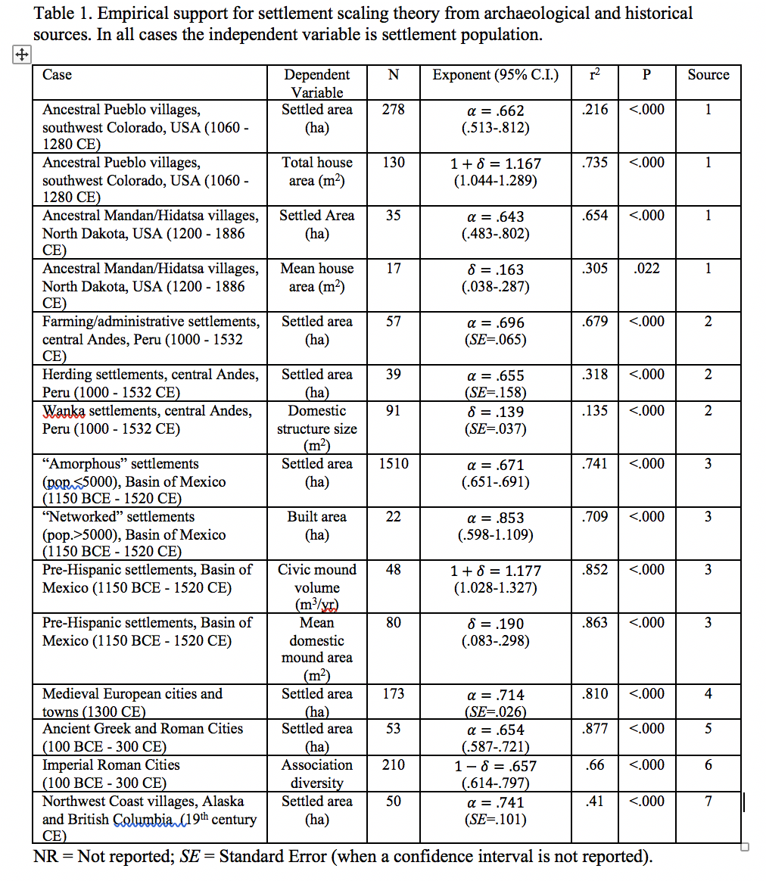
Ortman et al 2019
https://journals.sagepub.com/doi/10.1177/0042098019873796
Notes:
Many other studies of historical cities have been made with consistent results to these, but each also with its own story, data and so on. Here is a table and link to a recent review.

Slide 29
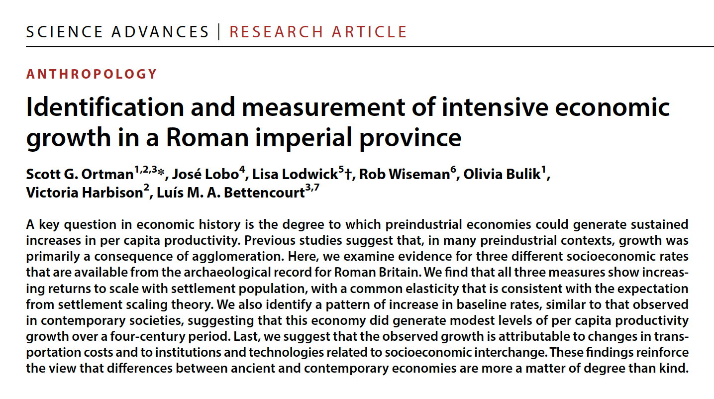
Economic growth in Roman Britain
Economic growth is not a model invention
https://www.science.org/doi/epdf/10.1126/sciadv.adk5517

Slide 30
Cities in History
Evidence for consistent urban scaling throughout history, culture and geography for
Densification of Settlements :
Amorphous and Networked
Increasing Returns in Socioeconomic Productivity
Division of Labor and Knowledge
Urban Systems
Political and Technological “Sophistication”
Episodic economic growth
Notes:
In summary, … cities are very old and diverse but there are many communalities about what they are fundamentally as social networks over space that we see in all these examples.

Slide 31

This allows us to establish a science of cities throughout history and read the past in terms of socioeconomic processes
credit:Gabriel Garcia

